Slide 1
Computer FUNDAMENTALS LEC 2
BY AADYAA SRIVASTAVA

Slide 2
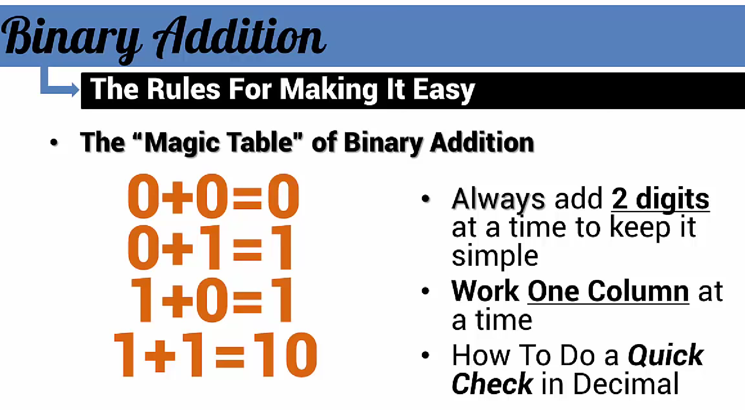
Binary Addition

Slide 3
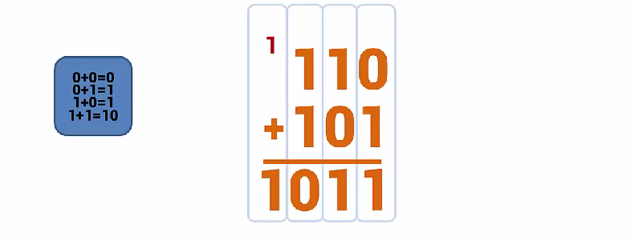
EXAMPLE 1

Slide 4
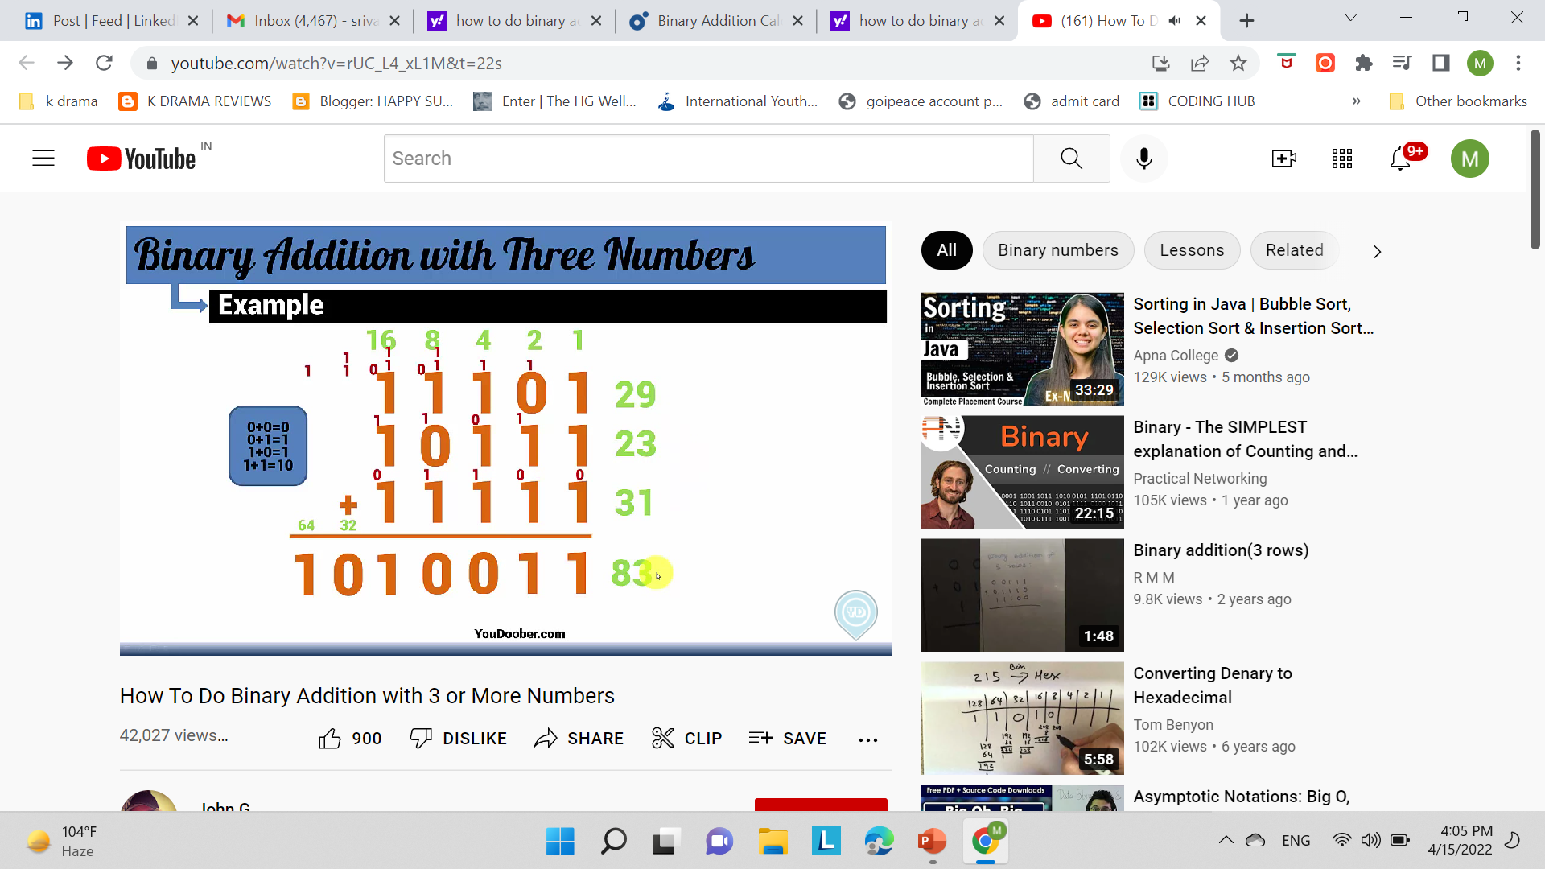
EXAMPLE 2

Slide 5
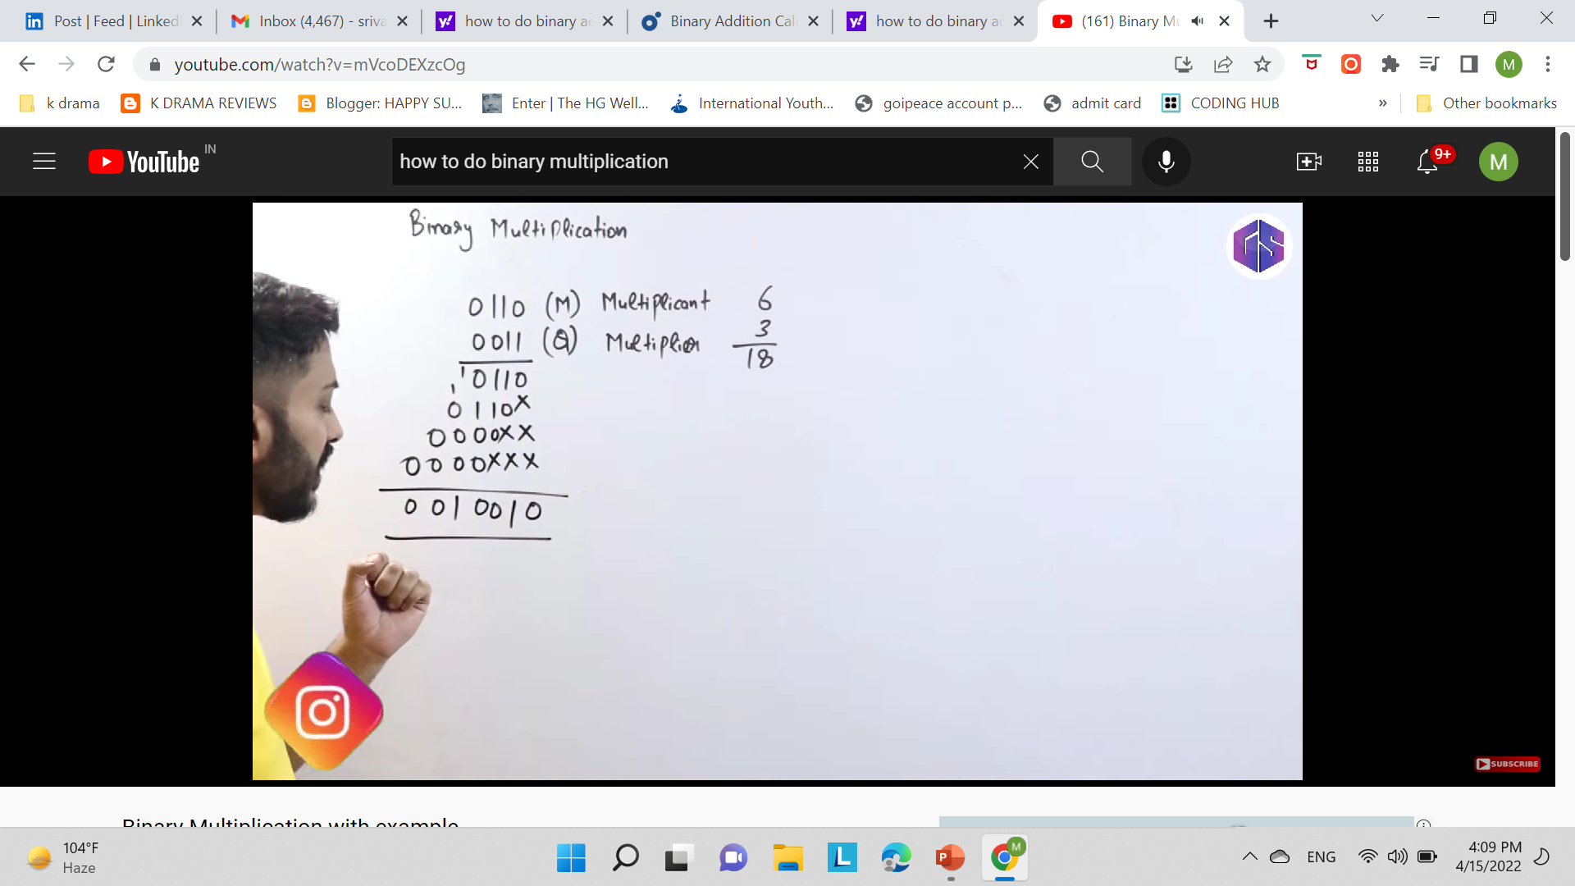
Binary multiplication

Slide 6
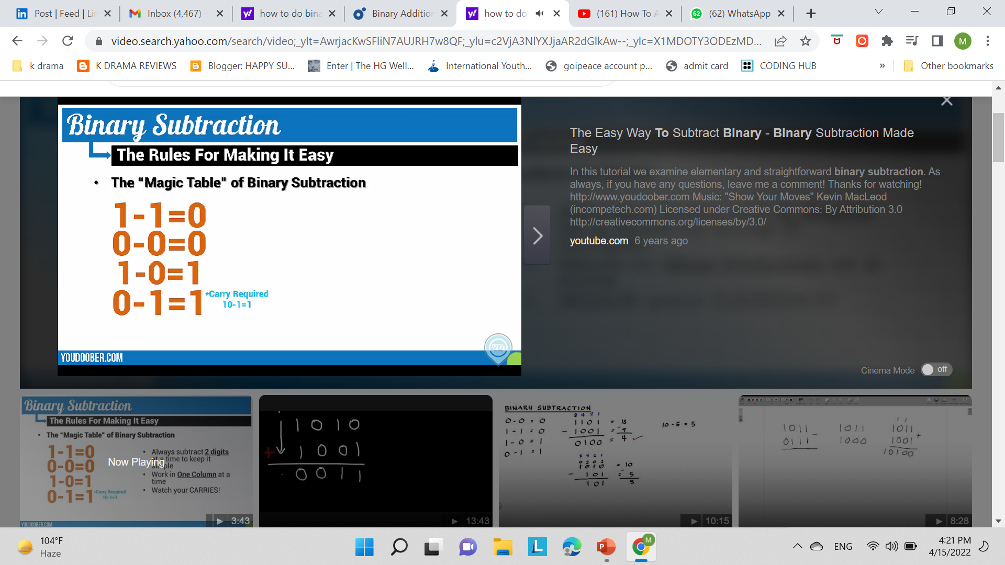
Binary subtraction

Slide 7


Slide 8
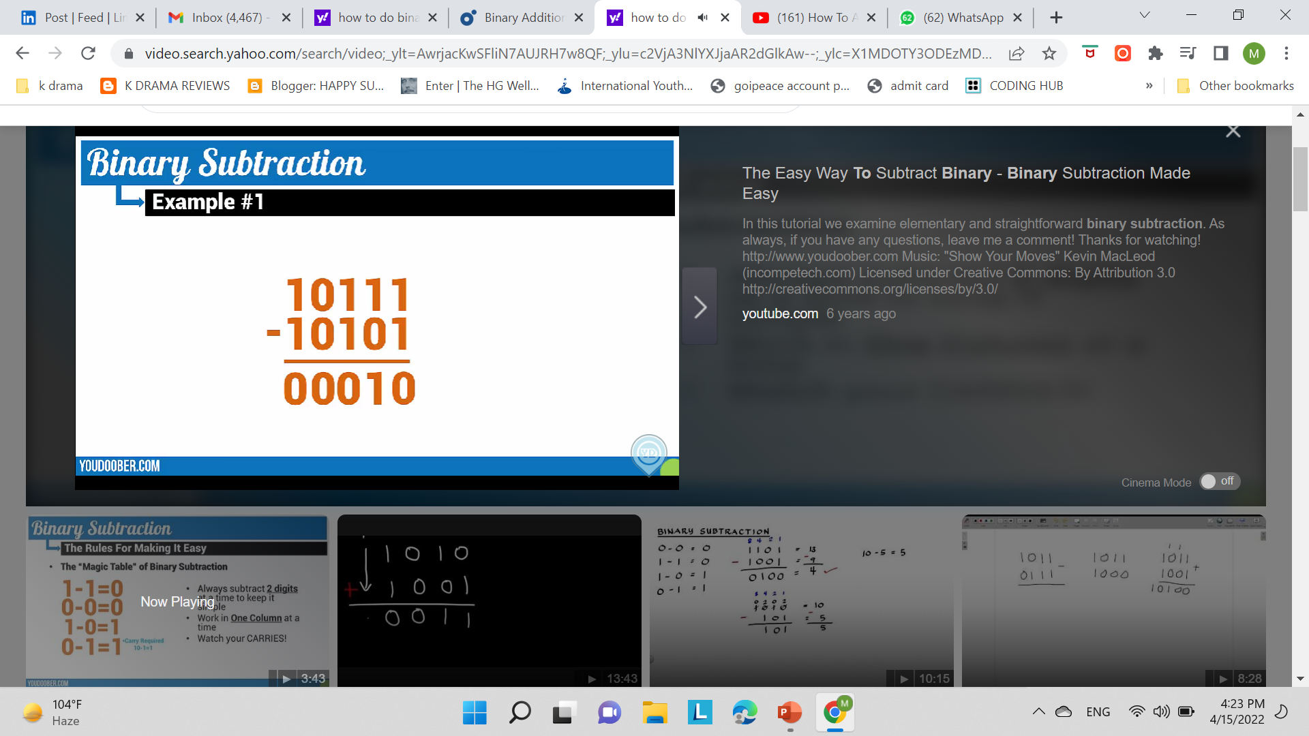

Slide 9
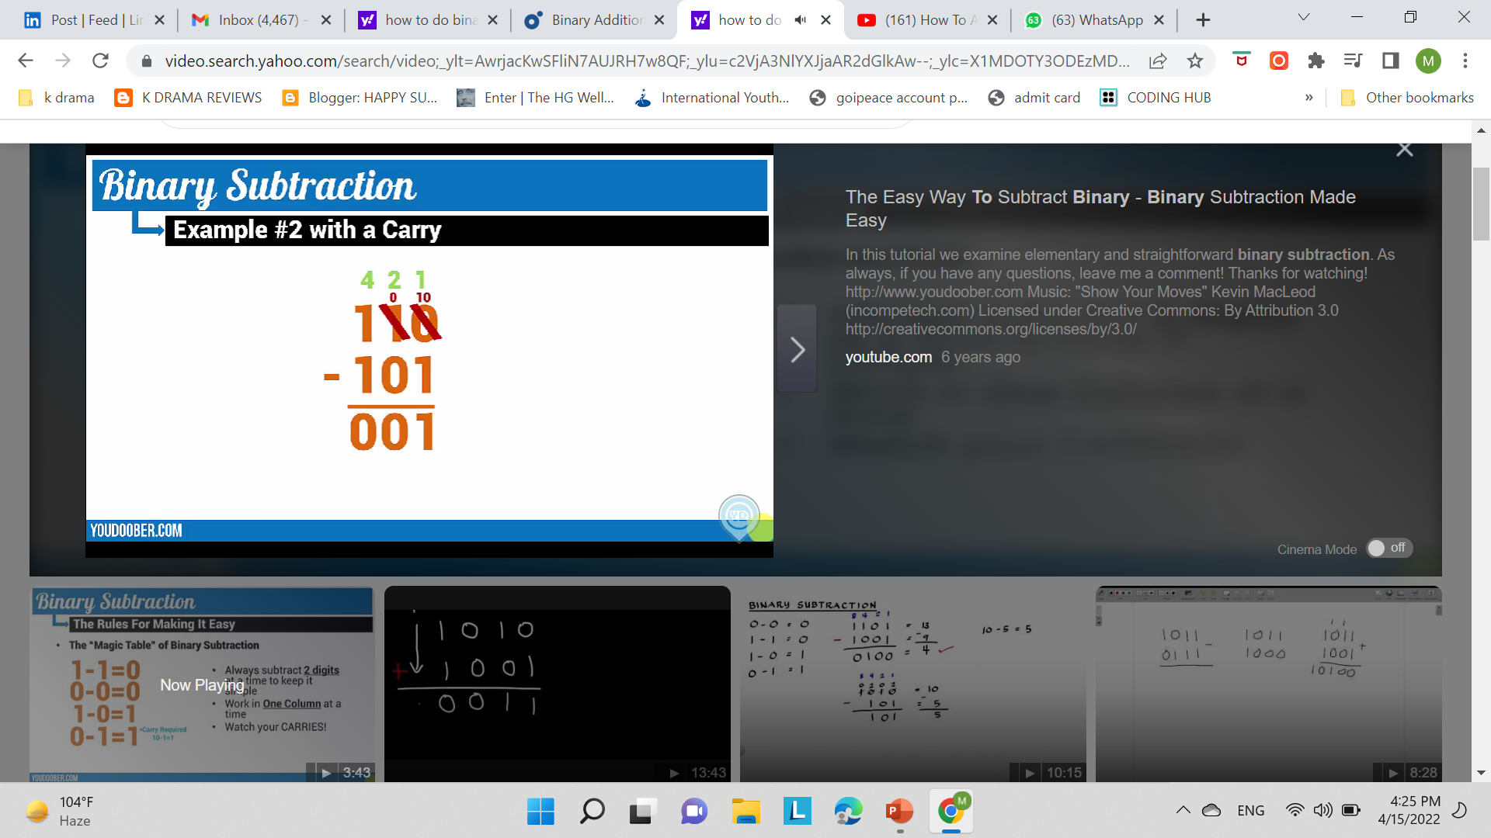
Here we made LSB 10 after taking a carry and carry 10 is 2 in decimal no so then we did 2 -1 which gave us result 1.

Slide 10
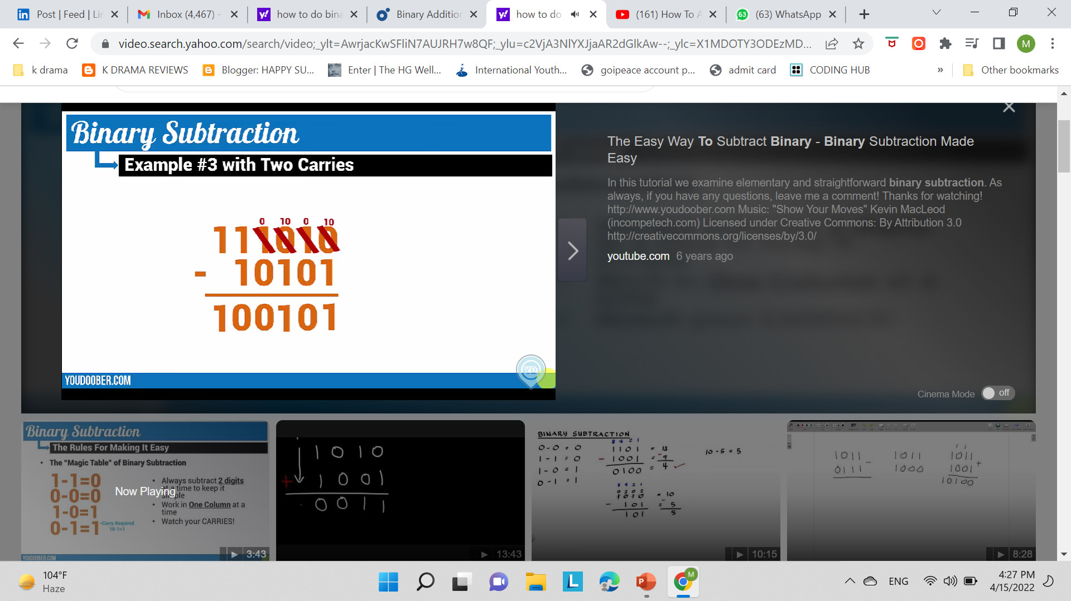

Slide 11
Negative binary
We represent negative binary numbers using a minus symbol in front of them. In computer number representation, these numbers can be distinguishable with the help of an extra bit or flag called sign bit or sign flag in the Binary number representation system for signed numbers. This extra bit is called sign bit or sign flag which has a value of sign bit is 0 for positive numbers and 1 for negative binary numbers.
The representation of magnitude of positive numbers is easy and does not need any changes.
The representation of magnitude of negative numbers is changed accordingly to represent it

Slide 12
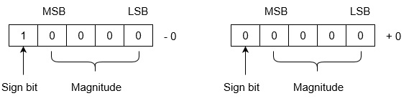

Slide 13
We will be using 2’s complement

Slide 14
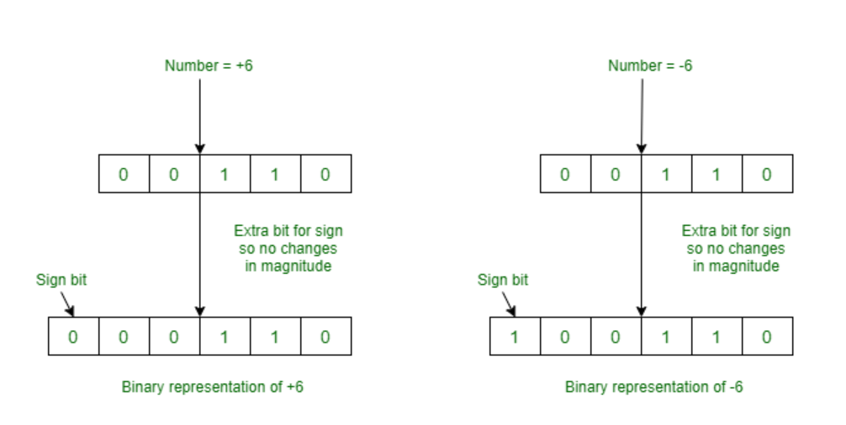

Slide 15
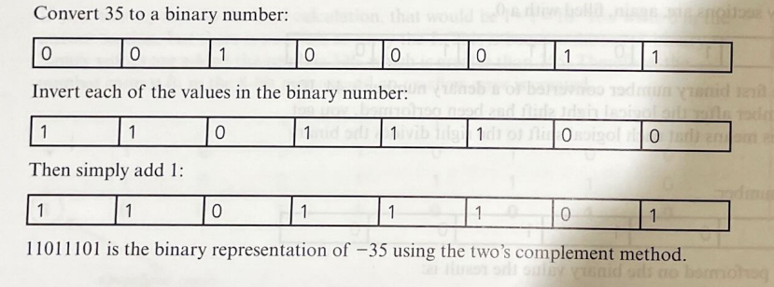
EXAMPLE FROM YOUR BOOK

Slide 16
DIY
-98
-210
-56
-34
-17
-11
-7
-45
-52
CONVERT –VE DENEARY NUMBERS INTO BINARY NUMBERS

Slide 17
worksheets

Slide 18
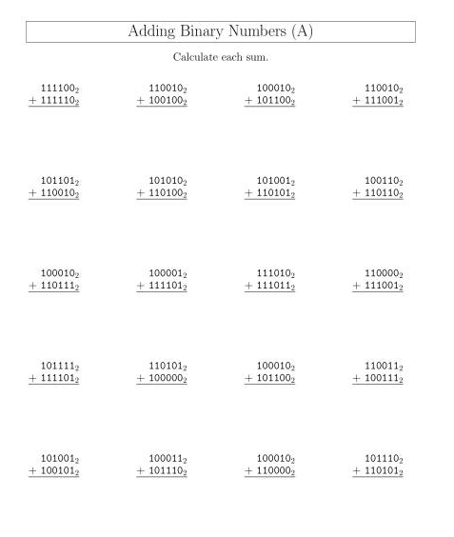

Slide 19
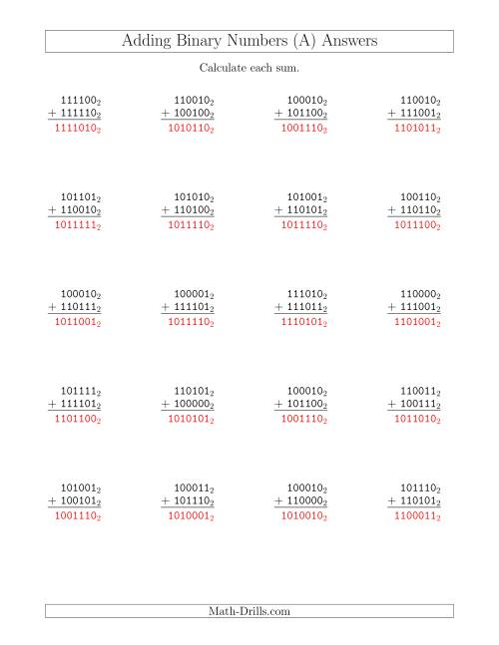

Slide 20
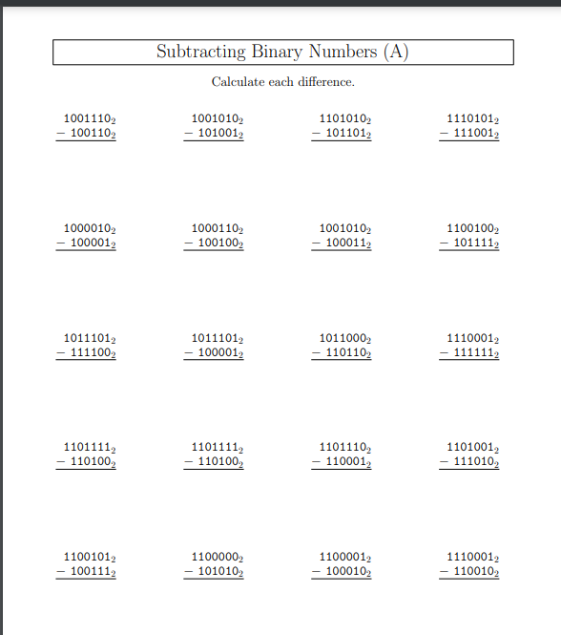

Slide 21
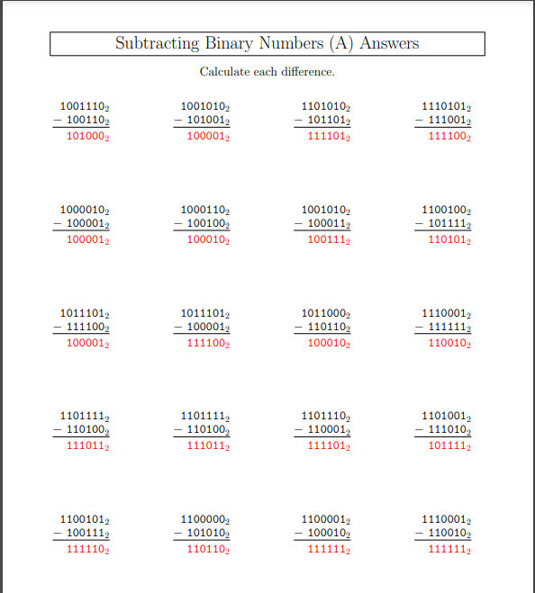

Slide 22
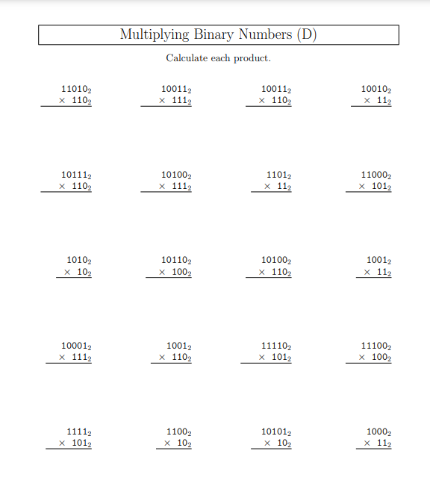

Slide 23
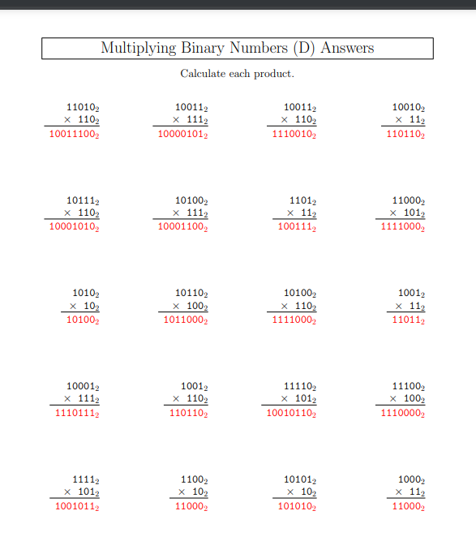

Slide 24
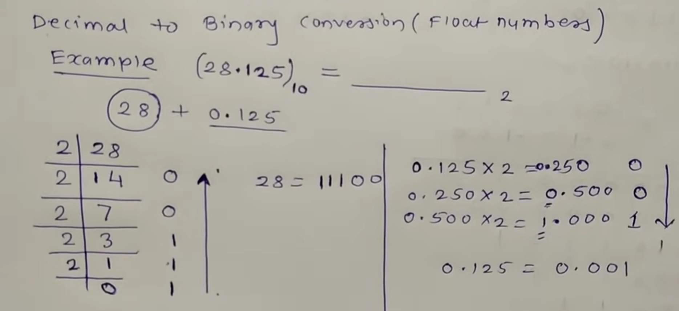
Convert no with decimal into binary

Slide 25
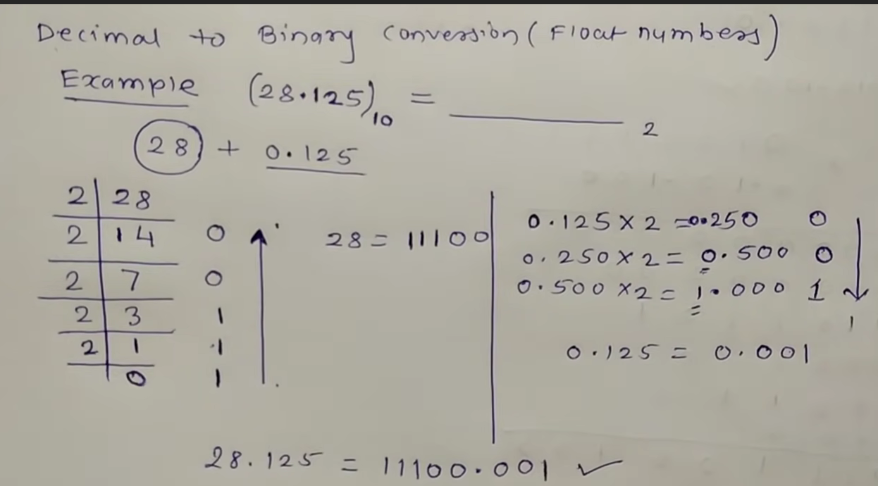

Slide 26
DIY
28.136
72.04
78.022
46.033
123.0126
1711.012
Convert decimal no to binary

Slide 27
Thankyou

